Slide 1

Job Market Dashboard
Final Presentation
Bhavya Sharma
5/14/25

Slide 2

Agenda
Project Overview
Repository Structure & Documentation
Technical Details (ETL & Database)
Streamlit Dashboard Demo
CS Concepts & OOP
Parsing Demo
references

Slide 3
Project Overview
Objective: To build a comprehensive, interactive dashboard that helps users explore high-paying data analyst job trends, identify in-demand skills, and prioritize which skills to learn based on both salary potential and market demand.
Key Features:
Real-time querying of PostgreSQL database via Streamlit web interface
Visual insights into:
Top-paying job titles
Highest-paying technical skills
Skill demand vs. average salary tradeoffs
Optimal skills ranked by a weighted usefulness score
SQL parser and execution demo for enhanced transparency and customization
Tech Stack: Python, Streamlit, PostgreSQL, SQLAlchemy, Pandas, Seaborn, Matplotlib
Data Source: https://drive.google.com/drive/folders/12f6YdpTguBmocpmCqBaB8zDrT4rovCxx?usp=sharing

Slide 4
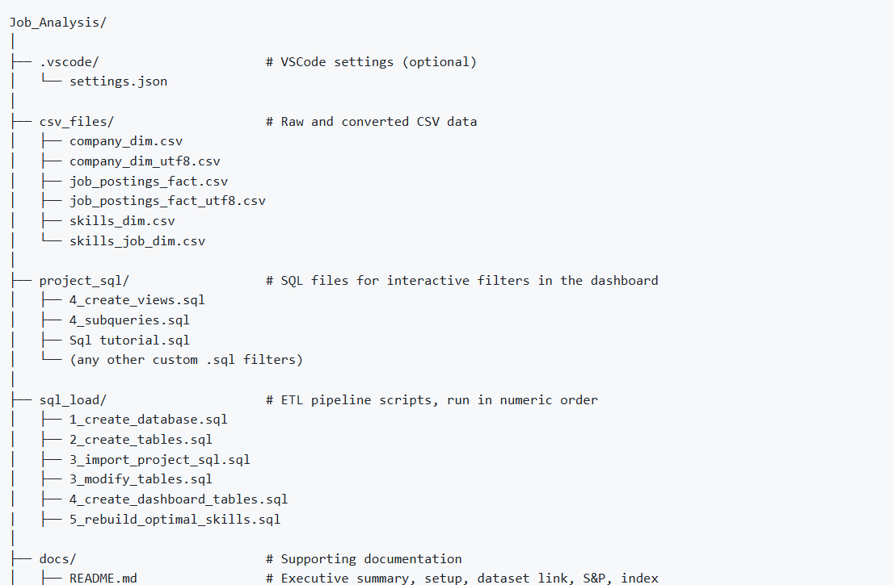
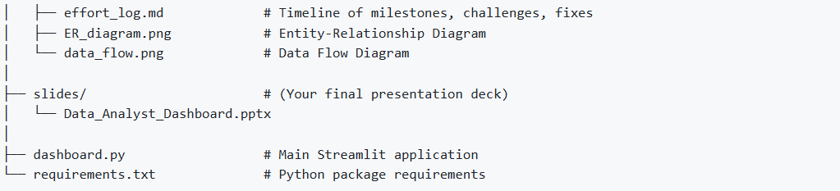
Repo Structure & Documentation

Slide 5
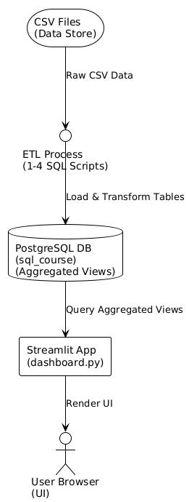
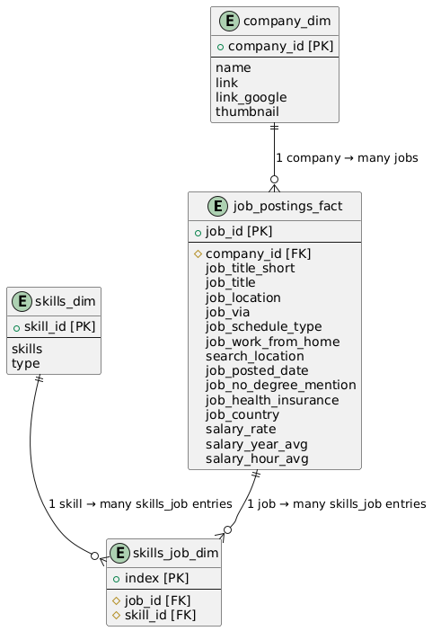
ERD AND DFD

Slide 6
Technical Details
1. Data Pipeline
Raw CSVs stored in csv_files/
ETL driven by SQL scripts in sql_load/
Step 1: Create database & tables
Step 2: Load raw CSV into dimensional model
Step 3: Import dashboard‐specific tables (top-paying jobs/skills, optimal skills)
Step 4: Build materialized views for fast queries
2. Database Design
PostgreSQL star schema:
Fact: job_postings_fact (all job records)
Dims:
company_dim (company metadata)
skills_dim (skill names & types)
skills_job_dim (many-to-many link)
Pre-aggregated tables (top_paying_jobs, etc.) live alongside raw tables
3 Backend & Languages
Python 3.9+
SQL + psycopg2 for database connectivity
Pandas for data manipulation
sqlparse to pretty-print SQL snippets
4. Frontend & Visualization
Streamlit framework for the interactive dashboard
Seaborn (built on Matplotlib) for:
Salary distribution histograms
Bar charts of top companies
Scatter plots of skill demand vs. pay
Sidebar filters: minimum salary slider and skill search box
5. Object-Oriented Design
DatabaseClient class handles all SQL connections and queries
JobDashboard class wraps data loading, filtering, and rendering logic
6. Scoring & Normalization
“Usefulness” score rescales raw optimal_score into a 1–10 range
Caps salaries above $200k to avoid chart distortion

Slide 7
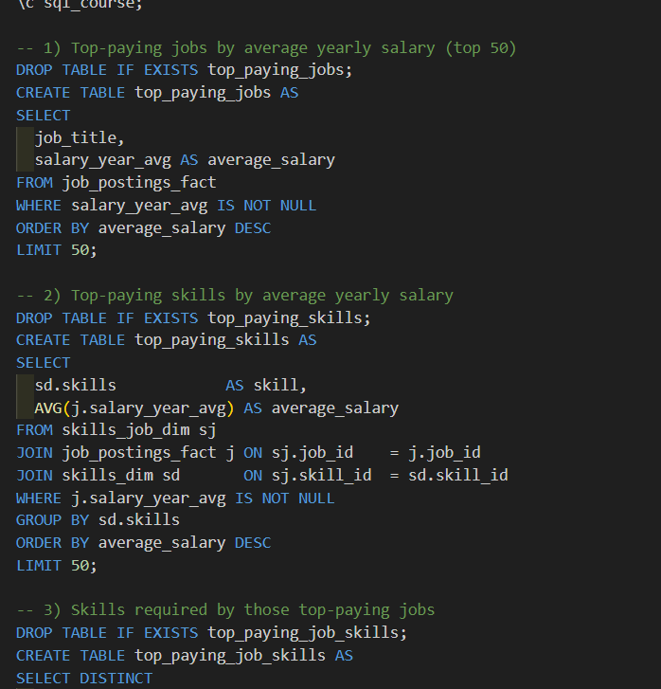
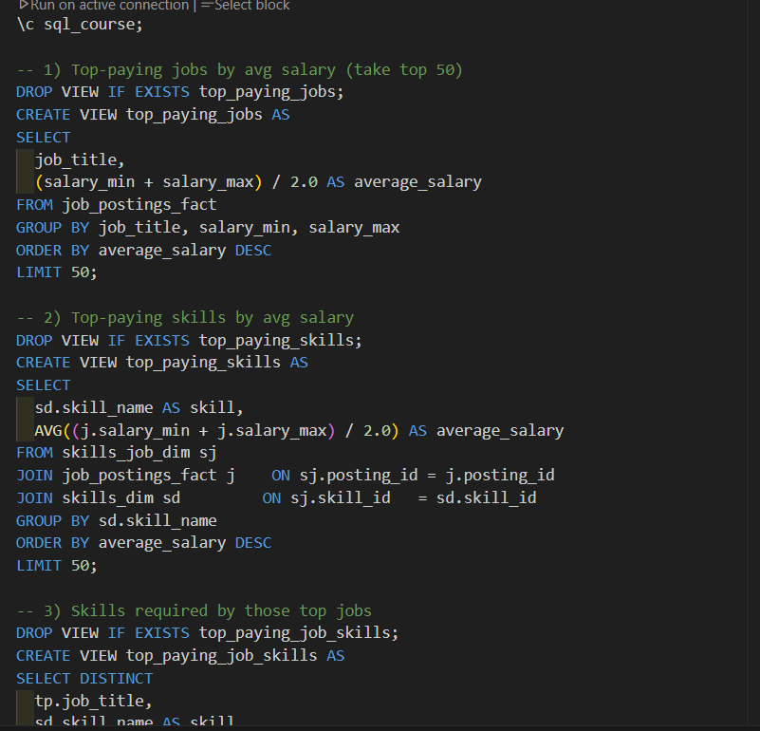
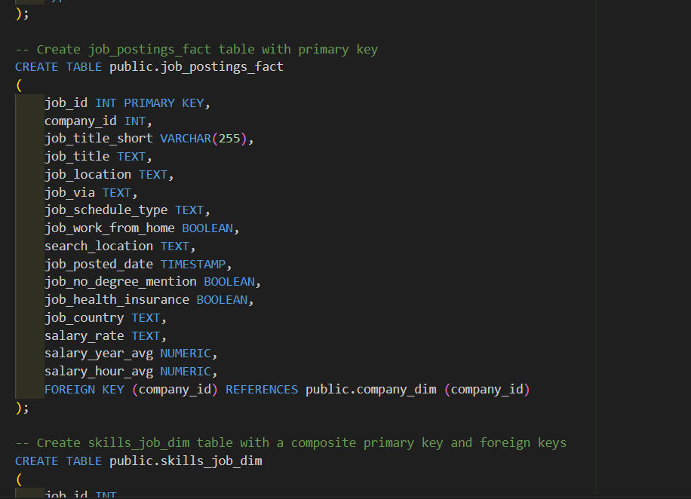
code snippets

Slide 8
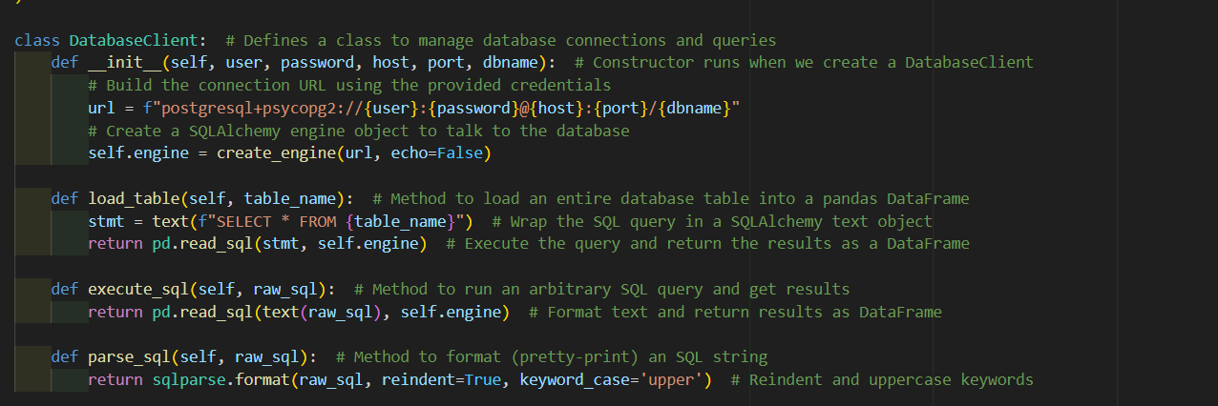
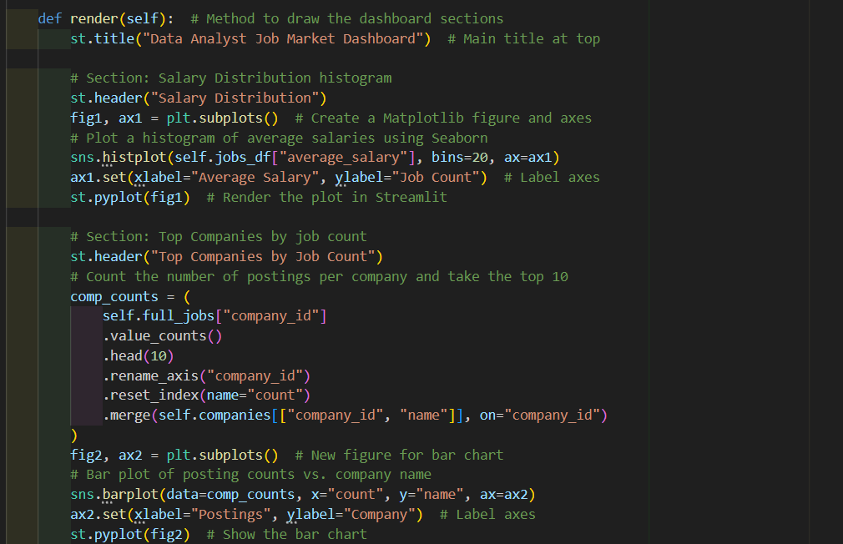
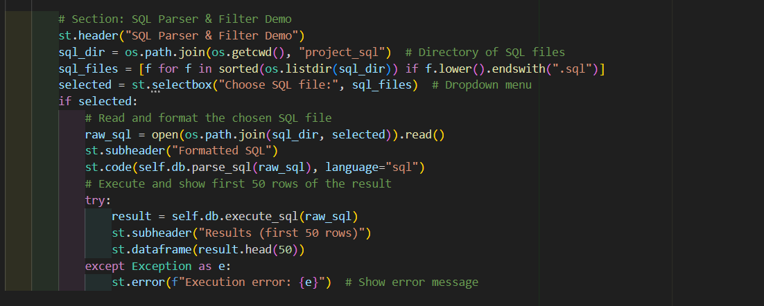
Code snippets
Loading etl from pSql: \copy company_dim FROM 'csv_files/company_dim.csv' CSV HEADER;
\copy job_postings_fact FROM 'csv_files/job_postings_fact.csv' CSV HEADER;
\copy skills_job_dim FROM 'csv_files/skills_job_dim.csv' CSV HEADER;

Slide 9
Parsing Demo
1. We import the sqlparse library, which provides the .format() function. 2–3. We also need os (to locate files) and Streamlit for UI components. 4. We point at our project_sql/ folder and grab every filename ending in .sql. 5. st.selectbox renders a dropdown of those filenames so the user can choose one. 6. Once selected, we open and read the raw SQL text from disk. 7. We pass that raw text into sqlparse.format() with two key options:
reindent=True splits long statements onto multiple, nested lines
keyword_case='upper' forces all SQL keywords into uppercase for consistency 8. We render the resulting “pretty” SQL in a monospace code block via st.code(). 9. We then run the original raw_sql against Postgres and show you the first 50 rows of its output—so you can both see exactly what the query looks like and verify what it returns.

Slide 10
Streamlit Dashboard Demo
Key Interactive Elements:
Sidebar Filters
Minimum Salary Slider
“Skill contains…” Text Search
SQL File Selector
Main Panels
Salary Distribution (Histogram)
Top Companies by Postings (Bar Chart)
Skills: Demand vs. Salary (Scatter Plot)
SQL Parser & Results (Formatted SQL + Preview of Query Output)
Optimal Skills Table (Normalized 1–10 “Usefulness”)
Let S be the list of raw optimal_score values
Let minS = minimum of S, and maxS = maximum of S
If maxS == minS: usefulness = 10 Else: usefulness = 1 + 9 * (optimal_score – minS) / (maxS – minS)

Slide 11
CS Concepts & OOP
Core CS Ideas We Used
Data Structures
Pandas DataFrames to store and manipulate our tables
Python lists for things like file names and filter inputs
Algorithms & Loops
Group-by and aggregate (counting and averaging) to summarize data
Score normalization (stretching raw values into a 1–10 scale)
Iterating over files and DataFrame rows to build charts and tables
Parsing
The sqlparse library to automatically reformat any SQL query for display
Database Design
A classic star schema: one big fact table (job_postings_fact) and three dimension tables
A simple ETL pipeline: Extract from CSV, Transform in SQL, Load into Postgres
How We Structured the Code (OOP)
DatabaseClient
Holds connection details and raw database logic
Methods:
.load_table() to pull an entire table into Pandas
.execute_sql() to run any SQL and get back a DataFrame
.parse_sql() to pretty-print SQL text
JobDashboard
Manages filters, loads data, and draws every chart and table
Keeps UI code separate from database code for clarity and easy testing
This design makes each part of our app—data access, SQL formatting, and UI rendering—self-contained and simple to maintain.

Slide 12
References
Dataset
“Data Analyst Job Postings & Skills” from Kaggle https://sqliteviz.com/app/#/workspace?hide_schema=1
Tools & Libraries
Python 3.9+
Streamlit — https://streamlit.io/
Pandas — https://pandas.pydata.org/
SQLAlchemy & psycopg2 — https://www.sqlalchemy.org/ & https://www.psycopg.org/
Matplotlib — https://matplotlib.org/
Seaborn — https://seaborn.pydata.org/
sqlparse — https://github.com/andialbrecht/sqlparse
Technologies
PostgreSQL — https://www.postgresql.org/
Git & GitHub — https://github.com/
Inspiration & References
Real Python – In-depth tutorials on Python, Pandas, SQLAlchemy, and data visualization https://realpython.com/
DataCamp – Interactive courses on data analysis, SQL, and Streamlit https://www.datacamp.com/
FreeCodeCamp – Hands-on guides to pandas, Matplotlib, and building dashboards https://www.freecodecamp.org/

